Slide 1


Gujarat University School of Emerging Science and Technology PERT and CPM Topic: COVID-19 Vaccination Drive Sem-6 Data Science Hima Marvaniya-19(Enrollement no. – 202222600026) Kesha Patel-26(Enrollement no. – 202222600011) Mentor: Prof. Gautam Chauhan and Dr. Aakash Thakkar

Slide 2
Introduction:
The COVID-19 virus has become a global health crisis that requires large-scale vaccine to control the spread of the disease and protect the population. Planning a mass vaccination program is a logistical challenge that involves many factors such as vaccine supply, cold storage, assign healthcare workers and to provide vaccines in minimum time period.

Slide 3
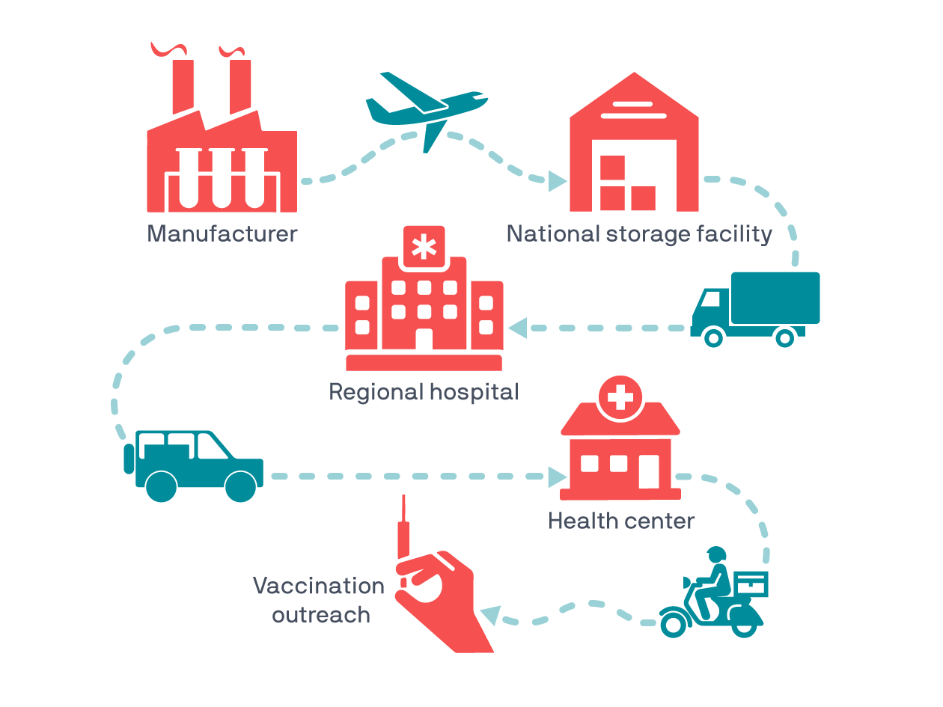
Objectives:
1.Vaccine availability: Ensure cold storage and availability of vaccines throughout the campaign.
2.Distribution setup: Organizing the most efficient delivery schedule to minimize vaccines transport time to vaccination centers.

Slide 4
3.Increase vaccine supply: Provide vaccine to the maximum number of eligible citizens within a specific time period.
4.Assign health centers to citizens: Assign registered individuals to the closest health centers for better accessibility.
5.Allocating healthcare workers: Assigning and allocating healthcare workers for different tasks and also train them. Ensuring that there are sufficient staff at vaccination centers.

Slide 5
6. Time needed to vaccinate a certain number of people: The time needed to vaccinate a specific number of people can be determined by setting the number of people who need to be vaccinated, the number of health centers that are available, the number of stations at each health center, and the total number of people to be vaccinated.

Slide 6
Literature Review:
The five-point strategy adopted by Indian government against COVID-19 has been “COVID appropriate behaviour, test, track, treat and vaccinate.”
The monopoly of central government in vaccine procurement resulted in bulk orders at low price rates. However, the implementation of liberalized policy lead to differential pricing and delayed achievement of set targets.

Slide 7
The population preference for free vaccines and low profit margins for the private sector due to price caps resulted in a limited contribution of the dominant private health sector of the country.
A wavering pattern was observed in the vaccination coverage, which was related majorly to vaccine availability and hesitancy.
The campaign will require consistent monitoring for timely vaccine supply and vaccine administration.

Slide 8
Because of vaccine shortages and hesitancy, the PERT (Program Evaluation and Review Technique) and CPM (Critical Path Method) models were employed to optimize pre-campaign strategies, vaccine supply chains, distribution processes, ensure availability of vaccine to vaccine centers and ensure timely availability of vaccines to the population.

Slide 9
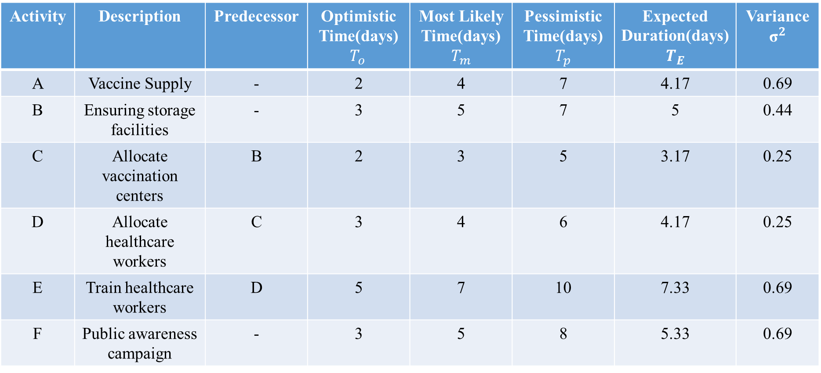
Activities:
1.Pre-Campaign phase
Activity | Description | Predecessor | Optimistic Time(days) $$T_{o }$$ | Most Likely Time(days) $$T_{m}$$ | Pessimistic Time(days) $$T_{p}$$ | Expected Duration(days) $T_{E}$ | Variance $${\text{σ}}^{2}$$
A | Vaccine Supply | - | 2 | 4 | 7 | 4.17 | 0.69
B | Ensuring storage facilities | - | 3 | 5 | 7 | 5 | 0.44
C | Allocate vaccination centers | B | 2 | 3 | 5 | 3.17 | 0.25
D | Allocate healthcare workers | C | 3 | 4 | 6 | 4.17 | 0.25
E | Train healthcare workers | D | 5 | 7 | 10 | 7.33 | 0.69
F | Public awareness campaign | - | 3 | 5 | 8 | 5.33 | 0.69

Slide 10
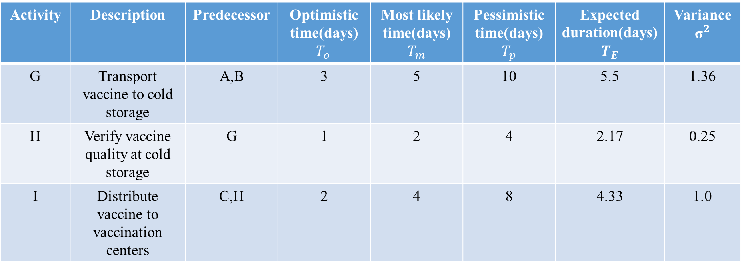
2.Supply chain and logistic phase
Activity | Description | Predecessor | Optimistic time(days) $$T_{o }$$ | Most likely time(days) $$T_{m}$$ | Pessimistic time(days) $$T_{p}$$ | Expected duration(days) $T_{E}$ | Variance $${\text{σ}}^{2}$$
G | Transport vaccine to cold storage | A,B | 3 | 5 | 10 | 5.5 | 1.36
H | Verify vaccine quality at cold storage | G | 1 | 2 | 4 | 2.17 | 0.25
I | Distribute vaccine to vaccination centers | C,H | 2 | 4 | 8 | 4.33 | 1.0

Slide 11
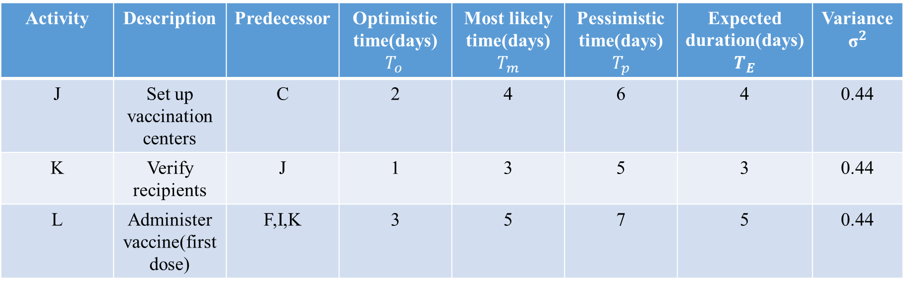
3.Operational phase
Activity | Description | Predecessor | Optimistic time(days) $$T_{o }$$ | Most likely time(days) $$T_{m}$$ | Pessimistic time(days) $$T_{p}$$ | Expected duration(days) $T_{E}$ | Variance $${\text{σ}}^{2}$$
J | Set up vaccination centers | C | 2 | 4 | 6 | 4 | 0.44
K | Verify recipients | J | 1 | 3 | 5 | 3 | 0.44
L | Administer vaccine(first dose) | F,I,K | 3 | 5 | 7 | 5 | 0.44

Slide 12
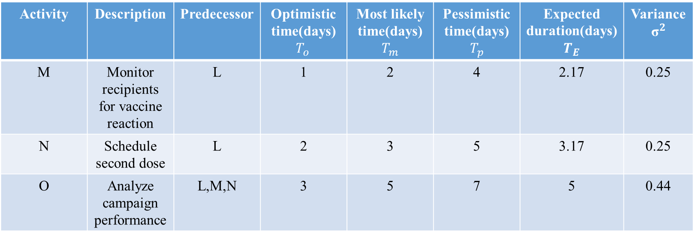
4.Post-Campaign phase
Activity | Description | Predecessor | Optimistic time(days) $$T_{o }$$ | Most likely time(days) $$T_{m}$$ | Pessimistic time(days) $$T_{p}$$ | Expected duration(days) $T_{E}$ | Variance $${\text{σ}}^{2}$$
M | Monitor recipients for vaccine reaction | L | 1 | 2 | 4 | 2.17 | 0.25
N | Schedule second dose | L | 2 | 3 | 5 | 3.17 | 0.25
O | Analyze campaign performance | L,M,N | 3 | 5 | 7 | 5 | 0.44

Slide 13
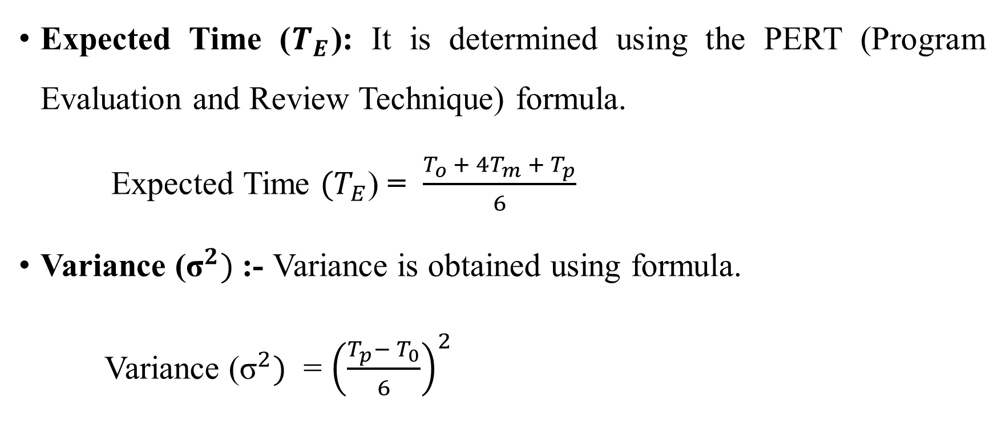
Methodology:
Expected Time ($T_{E}$): It is determined using the PERT (Program Evaluation and Review Technique) formula.
Expected Time $(T_{E}$) = $\frac{T_{o }+ 4T_{m} + T_{p}}{6}$
Variance ${\text{(}\text{σ}}^{2})$ :- Variance is obtained using formula.
Variance ${\text{(}\text{σ}}^{2})$ = ${\left(\frac{T_{p}−{T_{0}}}{6}\right)}^{2}$

Slide 14
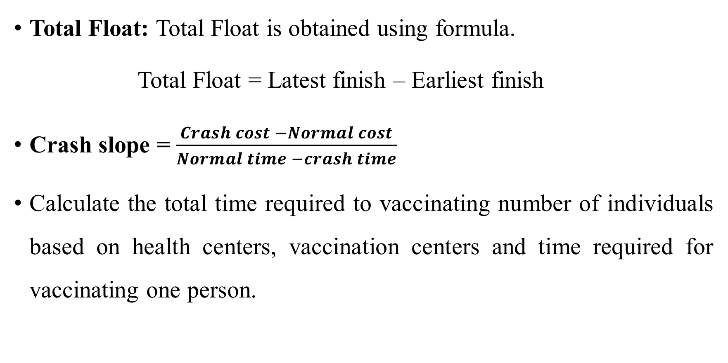
Total Float: Total Float is obtained using formula.
Total Float = Latest finish – Earliest finish
Crash slope = $\frac{Crash cost −Normal cost}{Normal time −crash time}$
Calculate the total time required to vaccinating number of individuals based on health centers, vaccination centers and time required for vaccinating one person.

Slide 15
The application of Project Evaluation and Review Technique(PERT) and Critical Path Method(CPM) techniques in managing these tasks ensures that the project is completed in minimum time period while optimizing the use of resources and minimizing delays.
Link for code:
https://colab.research.google.com/drive/1byU_ZQBibxVk63nwXppWolSy0Zpj5rj4?usp=sharing

Slide 16
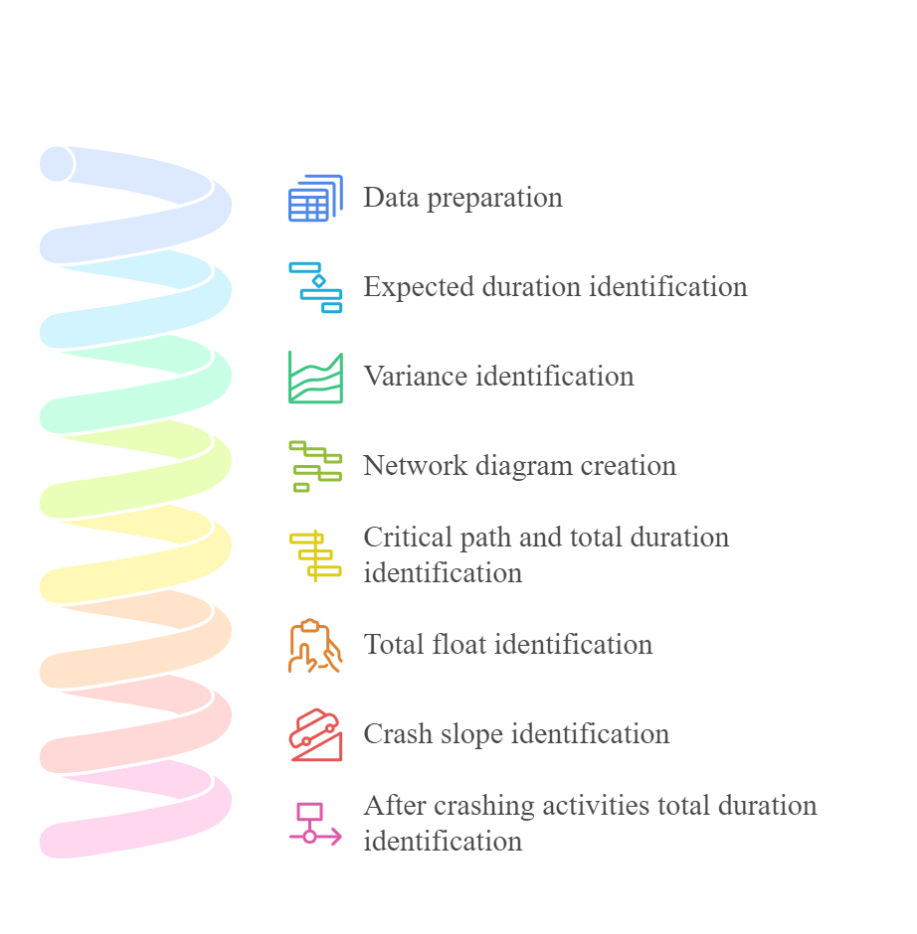
Framework:

Slide 17
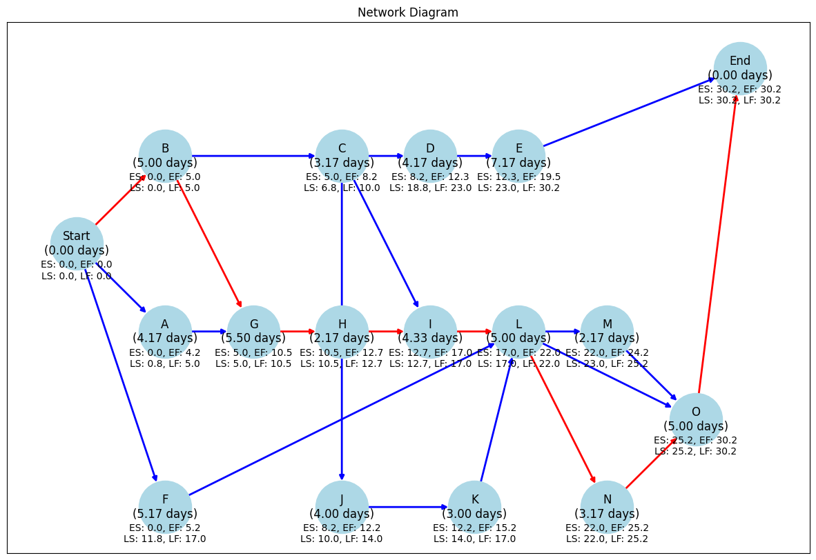

Slide 18
Observation:
Critical Path: Start B G H I L N O End . This critical path containing activities are dependent activities. Any delay in this activities can affect the project’s timeline. This activities require strict monitoring to avoid delays.
Non-critical activities are flexible that can be rescheduled to avoid conflicts and resource utilization.
The Total duration of vaccination drive is 30.17 days.

Slide 19
Higher variance of the critical path activities can delay project’s timeline.

Slide 20
The crash slope represented the additional cost added to reduce time of the project.
Activities on the critical path are prioritized for crashing because they directly impact the project's total duration.
Higher crash slope indicates that reducing the activity duration is more expensive.
Lower crash slopes of critical path activities are cost-effective to shorten project duration.

Slide 22
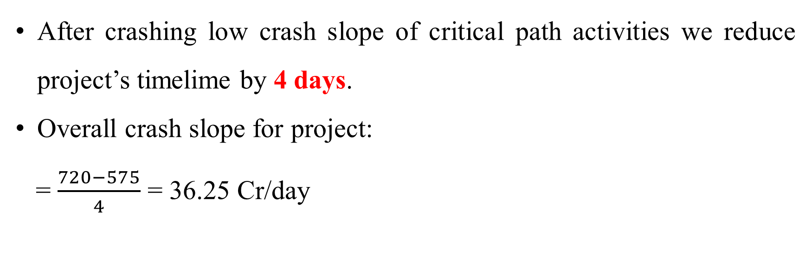
Total normal cost | ₹ 575 crores
Total crash cost | ₹ 145 crores
Total cost (after crashing) | ₹ 720 crores
After crashing low crash slope of critical path activities we reduce project’s timelime by 4 days.
Overall crash slope for project:
= $\frac{720−575}{4}$ = 36.25 Cr/day

Slide 23
All critical activities have zero total float.
Non-critical activities can be delayed up to the total float value without delaying the project.
Low or zero float are more risky activities because it directly affect project’s timeline.
High float or positive float can be delayed without affecting the overall project timeline.

Slide 25
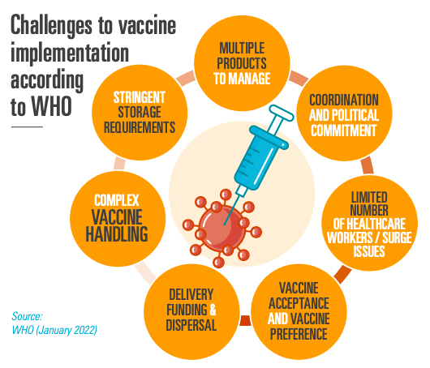
Challenges:
Vaccine supply
Ensuring storage facilities
Transport vaccine to cold storage
Verify vaccine quality at cold storage
Distribute vaccine to vaccination centres
Administer vaccine(first dose)

Slide 26
Schedule second dose
Analyze campaign performance
In order to overcome the challenges in COVID-19 vaccine distribution and administration, we need better infrastructure, smart technology and strong partnerships. Key steps includes improving cold chain systems, using advanced logistics for transport and real-time monitoring to keep vaccines effective.
Efficient scheduling, follow-ups and performance tracking are crucial to ensuring success.

Slide 27
Conclusion:
Using PERT and CPM helped manage COVD-19 vaccination campaign effectively. These methods made strategic planning and organizing minimum time period. It showed how important data-decision are in public health efforts. This structured way of working can be model for future large-scale health projects, ensuring resources are used wisely and goals are achieved on time.

Slide 28
Reference:
Neha Purohit,Yashika C.,Pankaj B.,Shankar Prinja (2022). COVID-19 management: The vaccination drive in india. Health Policy and Technology,11, Article 100636. pages: 3-5

